Slide 1
養生
Yǎngshēng: the art of nourishing life

Slide 2
養生
The sages did not treat those already ill, but treated those not yet ill…
When drugs are employed for therapy only after a disease has become fully developed…this is as if a well were dug when one is thirsty
-Huang Di Nei Jing Su Wen Chapter 2
Unschuld & Tessenow trans.
2000 Year Old Text

Slide 3
agenda
INTRODUCTION 4
WOOD 19
FIRE 25
METAL 30
WATER 35
EARTH 40
CONCLUSION 44

Slide 4
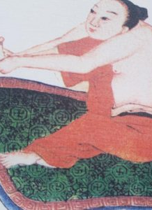
introduction

Slide 5
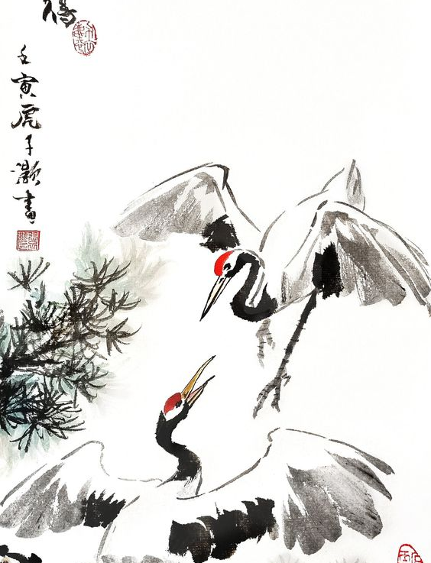
養生
Nourishing Life
A HOLISTIC approach to maintaining and ENHANCING health and longevity. It aims to HARMONIZE the body's internal environment with external conditions.

Slide 6
Huang Di Nei Jing Su Wen Chapter 1
Unschuld & Tessenow trans.
Huang Di:
I have heard that the people of High Antiquity… all exceeded 100 years, but in their movements there was no weakening. As for people of today, after one half of a hundred years, the movements and activities of all of them weaken.
Qi Bo:
The people of High Antiquity, those who knew the Way [Dao], they modeled [their behavior] on yin and yang, and they complied with the arts and the calculations [calendar]. Their eating and drinking were moderate. Their rising and resting had regularity. They did not tax [themselves] with meaningless work.

Slide 7
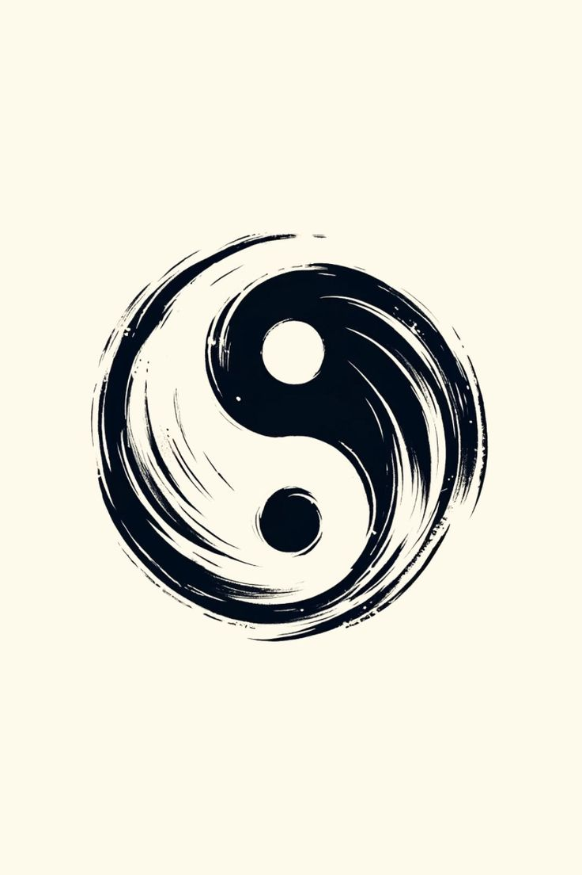
Yin and Yang
陰陽
“Yīn and yáng are the Dào of Heaven and Earth, the lead rope and connecting strands of the myriad things, the father and mother of biàn and huà change, the foundation and beginning of giving life and of taking it, and the palace of shén míng.”
黃帝曰︰陰陽者，天地之道也，萬物之綱紀，變化之父母，生殺之本始，神明之府也。(Huangdi Neijing Suwen Chapter 5 “The Great Treatise on Yin-Yang Resonating in the Manifest World” – Sabine Wilms trans.

Slide 8
Important Characteristics of Yin and Yang
Opposition
Interdependence
Inter-transformation
Infinite Divisibility
*Yin and Yang are RELATIONAL and FUNCTIONAL categories, they never exist
independently of each other

Slide 9
Opposition
Temporal Opposition
Yang Yin
Day Night
Noon Midnight
Summer Winter
Fast Slow
Activity Stillness
Spatial Opposition
Yang Yin
Heaven Earth
Up Down
Front of a Classroom Back of a Classroom
Back of Body Front of a Body

Slide 10
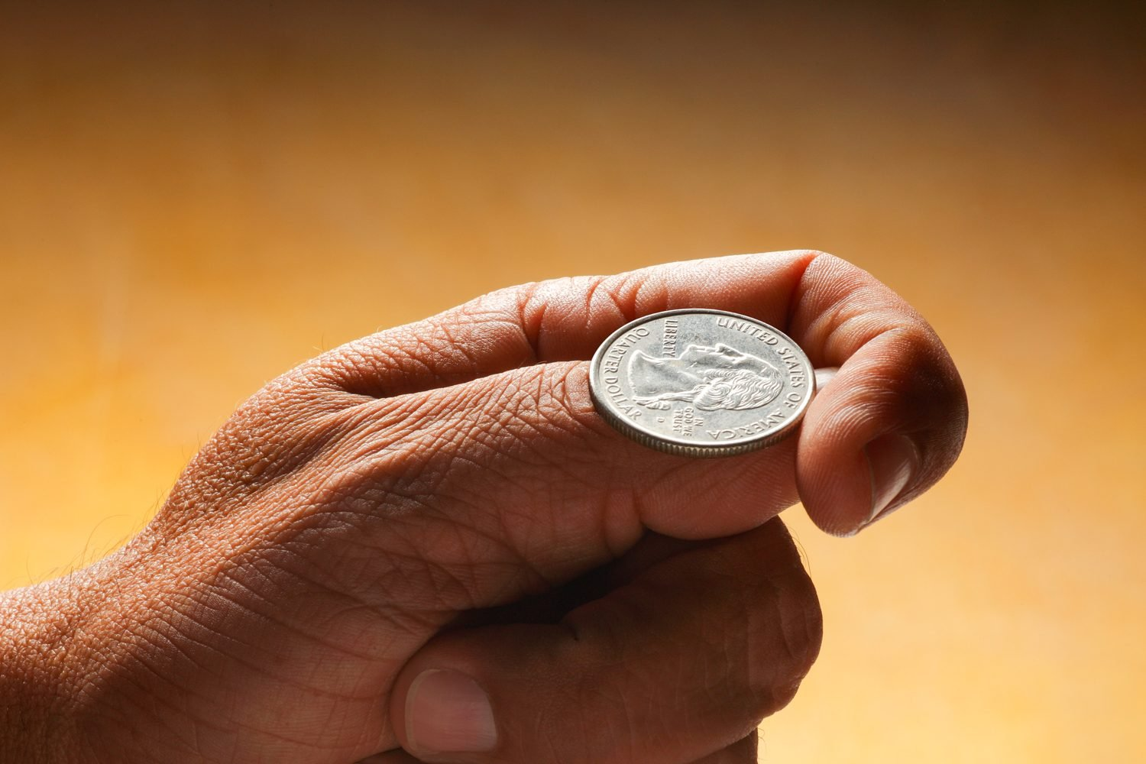
Interdependence
One cannot exist without the other.
Structure = Yin
Function = Yang
Inhalation=Yin
Exhalation=Yang

Slide 11
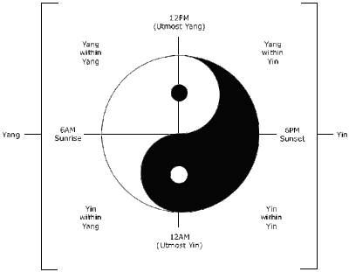
Inter-transformation
Temporal or Spatial:
Spring into Summer
East into West

Slide 12
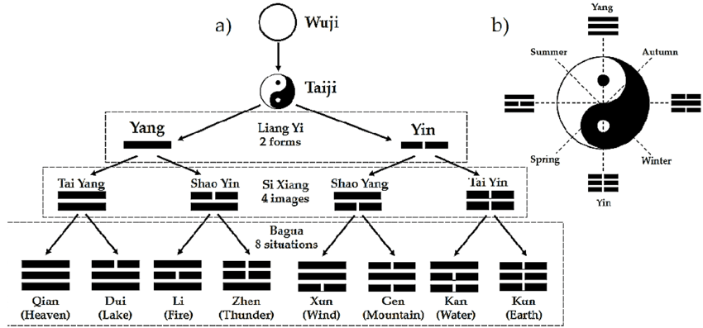
Infinite Divisibility
Similar to the concept of ‘Nesting’ in Systems Theory. Not only can you divide yin and yang infinitely, you can also expand it

Slide 13
炁
氣
Qi
What is it?
What is it not?

Slide 14
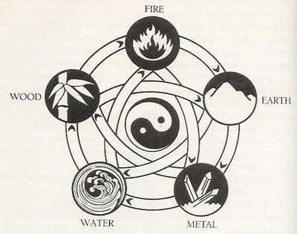
五行 Wǔ Xíng
5 Phases
or
Elements

Slide 15
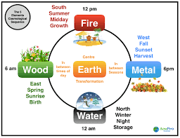
五行 Wǔ Xíng
5 Phases
or
Elements

Slide 16
Huang Di Nei Jing Su Wen Chapter 2
Unschuld & Tessenow trans.
…Yin, Yang, and the four seasons, they constitute end and begin of the myriad beings, they are the basis of death and life.
Opposing them results in catastrophe and harms life.
If one follows yin and yang, then life results;
If one opposes them, then death results.
If one follows them, then order results;
If one opposes them, then disorder results.

Slide 17
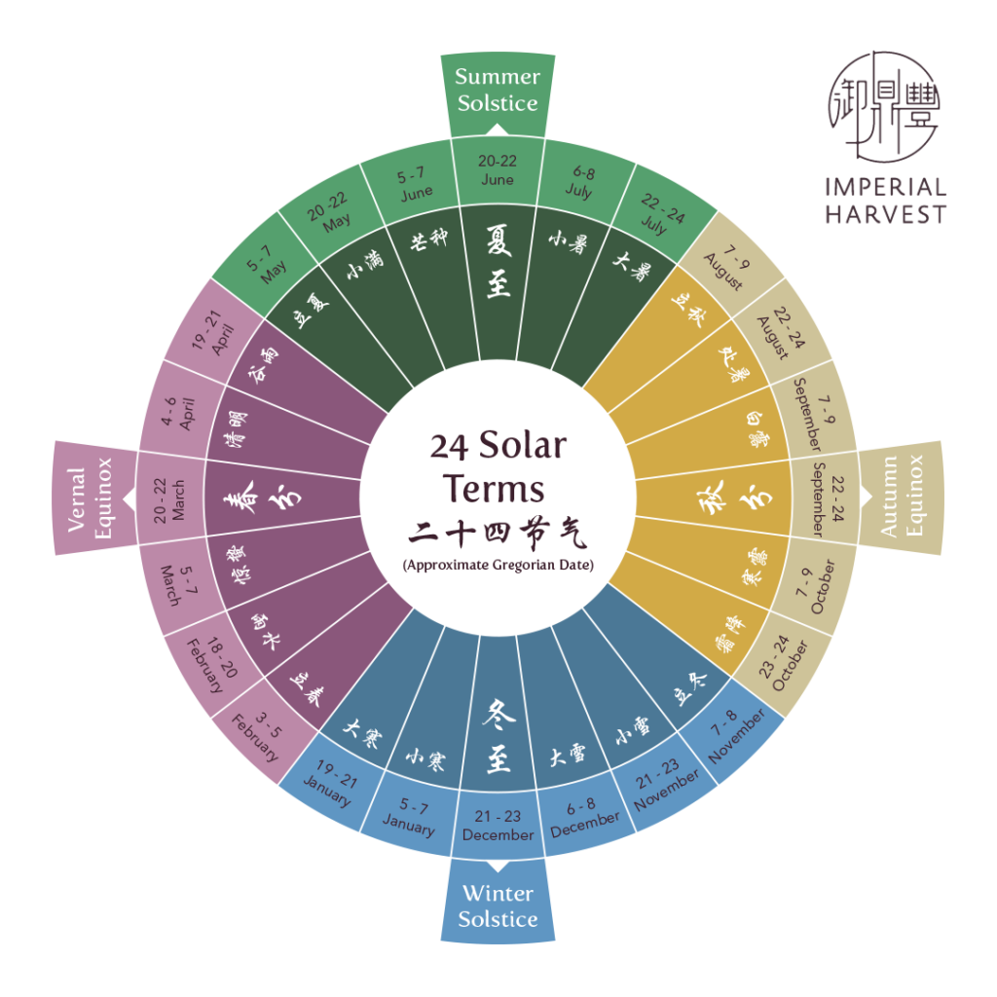
Chinese Calendrics:
Solar Terms

Slide 18
Chinese Calendrics:
24 hour clock

Slide 19

Wood
The 3 months of spring,
They denote effusion and spreading.
Heaven and Earth together generate life;
The myriad beings flourish.
Go to rest late at night and rise early.
Move through the courtyard with long strides.
Dishevel the hair and relax the physical appearance,
Thereby cause the mind [to orient itself on] life.
…This is correspondence with the qi of spring and it is the way to nourish life.
Huang Di Nei Jing Su Wen Chapter 2
Unschuld & Tessenow trans.

Slide 20
Wood
Resonance
Season | Spring
Direction | East
Yin Organ | Liver
Yang Organ | Gallbladder
Action | Growth
Flavor | Sour (Acrid to tonify)
Tissue | Tendons
Sense Organ | Eye
Color | Green
Negative Emotion | Anger
Virtue | Benevolence - Rén 仁

Slide 21
導引 Dǎo yǐn

Slide 22
Eye Health
Negative impacts of our modern environment challenge our eyesight. Constant detailed focus, computers, phones, and artificial can create problems with our vision.
Vision exercises help relax and rest the eyes, promoting more circulation into the tissues and surrounding tissues of the eyes
Exercise 1
  Massage hands to generate heat, hold palms up to eyes, let the warmth soak in
Exercise 2
  Dredge the eyebrows and below the eyes with the index fingers
Exercise 3
  Point press inner, middle, and end of eyebrow, rubbing in circles 30-40x each direction with the tip of the index fingers
  Point press directly below the eye on the cheekbone in the same fashion

Slide 23
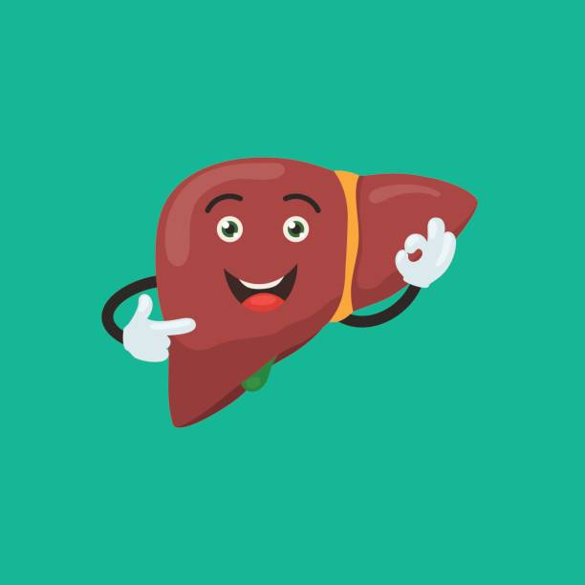
Liver Health
Hold both hands over Liver area (below breast, right side, under ribs)
Breath green light, like the color of springtime into the Liver.
Smile and tell yourself and your liver that you have no cares, no worries, everything is relaxed and easy
Bring that relaxed feeling out into the world, feeling compassion for others

Slide 24
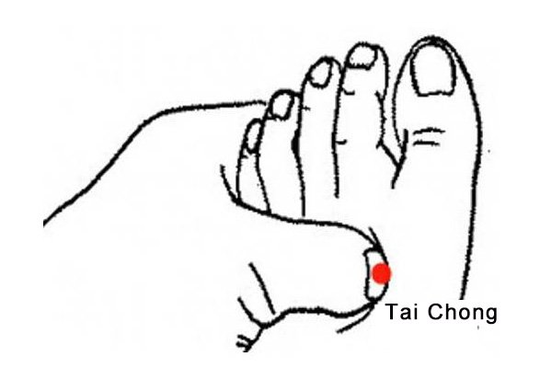
Point Press
太沖 – Liver 3
The Great Rushing
Potentially good for:
-Headache
-Dizziness
-Insomnia
-Vision Problems
-Menstrual Issues
-Fertility Issues
-Tendon issues

Slide 25
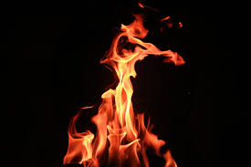
Fire
The 3 months of summer,
They denote opulence and blossoming.
The qi of Heaven and Earth interact and
the myriad beings bloom and bear fruit.
Go to rest late at night and rise early.
Never get enough of the sun.
Let the mind have no anger.
Stimulate beauty and have your elegance perfected.
Cause the qi to flow away,
as if that what you loved were located outside.
This is correspondence with the qi of summer
and it is the way to nourish life.
Huang Di Nei Jing Su Wen Chapter 2
Unschuld & Tessenow trans.

Slide 26
Fire
Resonance
Season | Summer
Direction | South
Yin Organ | Heart
Yang Organ | Small Intestine
Action | Expansion / Manifestation
Flavor | Bitter
Tissue | Vessels
Sense Organ | Tongue
Color | Red
Negative Emotion | Joy / Mania
Virtue | Propriety / Ritual - Lǐ 禮

Slide 27
心 Xīn
Heart / Mind
神 Shén
Spirit / Soul
The Shen (spirit) prefers clarity, yet the Xin (Heart-Mind) disturbs it.
The Xin (Heart-Mind) prefers stillness, yet desires pull it astray.
If one can constantly discard one’s desires, the Xin (Heart-Mind) will settle on its own.
Clarify the Xin (Heart-Mind), and the Shen (Spirit) will become clear on its own.
请静經 Qǐng jìng jīng
Scripture of Clarity & Stillness
Paynter & Schaefer trans.

Slide 28

Heart Health
Seated in a chair or cross legged, make the Lotus Flower Hand Seal / Mudra and hold in front of the chest.
Smile into the Heart and chest, relaxing and filling the area with red light, like the light of the morning sun
Smile and think of something you are thankful for.
Feel the gratitude tangibly inside the chest and slowly let it spread to the whole body, and then out into the world

Slide 29
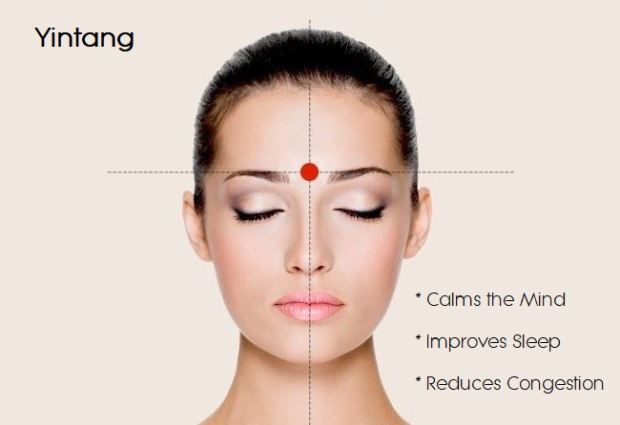
Point Press
印堂- Yìntáng
Hall of Impression
With the sides of the thumbs, massage from yin tang upwards to the hairline. Alternate with both thumbs.
Alternatively, you may use your index fingers to simultaneously massage in an arc from yin tang across the forehead to the temples.

Slide 30
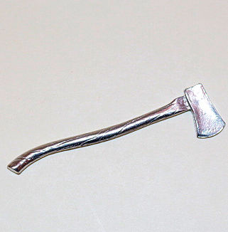
Metal
The 3 months of autumn,
They denote taking in and balance.
The qi of Heaven becomes tense.
The qi of Earth becomes bright.
Go to rest early and rise early.
Get up together with the chicken.
Let the mind be peaceful and tranquil, so as
To temper the punishment carried out in autumn.
Collect the spirit qi and
Cause the autumn qi to be balanced.
Do not direct your mind to the outside and
Cause the lung qi to be clear.
This is correspondence with the qi of autumn
and it is the way to nourish gathering.
Huang Di Nei Jing Su Wen Chapter 2
Unschuld & Tessenow trans.

Slide 31
Metal
Resonance
Season | Autumn
Direction | West
Yin Organ | Lung
Yang Organ | Large Intestine
Action | Withdrawal / Collection
Flavor | Acrid (Sour to tonify)
Tissue | Skin
Sense Organ | Nose
Color | White
Negative Emotion | Grief / Sadness
Virtue | Righteousness, justice - Yì 義

Slide 32
炁 /氣
If one cannot obtain medicines
One can live still to several hundred years of age,
If one fully grasps the principles
Of Cultivating Qi and practices daily.
Indeed, humans exist within the Qi
And Qi exists within the humans.
From Heaven and Earth to the myriad things,
Qi is pervasive.
There is nothing that does not rely on Qi for life.
抱樸子
Bào pǔ zi
Scripture of the Master who Embraces Simplicity
Jahnke trans.
Qi

Slide 33
Lung Health
Natural Breathing
  You can do this exercise seated, standing, or lying down.
  Place both hands on your lower abdomen
  Breathe in and out through the nose, following the breath with your mind
  Inhale the qi to your lower abdomen, filling the abdomen like a balloon filling. You should feel the expansion in your hands
  Exhale back out through the nose, imagining the balloon in the abdomen deflating. You should feel your abdomen deflating with your hands.
  Continue in this fashion until the breath becomes slow, even, and deep.
Full Body Breathing / Skin Breathing
  Once your breath becomes deep and even, imagine that you are breathing in and out through the pores of your skin
  Your whole body fills with qi / breath
  You can imagine that the qi / air is White Light, filling your body
  Continue for as long as you like

Slide 34
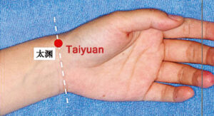
Point Press
太淵- Tàiyuān
Supreme Abyss
Locate at the wrist joint on the crease inside the wrist (palm up), in the dip between the radial artery and the tendon.
With hand resting comfortably on a surface, massage with a finger of the opposite hand in circles, clockwise then counterclockwise.
This is a general strengthening point for the lungs. It can have a deep (the name is supreme abyss) and powerful effect on the qi of the whole body, especially over time.

Slide 35

Water
The 3 months of winter,
They denote securing and storing.
The water is frozen and the Earth breaks open.
Do not disturb the yang.
Go to rest early and rise late.
You must wait for the sun to shine.
Let the mind enter a state as if hidden,
As if you had secret intentions;
As if you already had made gains.
Avoid cold and seek warmth and
Do not [allow sweat] to flow away through the skin.
This would cause the qi to be carried away quickly
This is correspondence with the qi of winter
and it is the way of nourishing storage.
Huang Di Nei Jing Su Wen Chapter 2
Unschuld & Tessenow trans.

Slide 36
Water
Resonance
Season | Winter
Direction | North
Yin Organ | Kidney
Yang Organ | Urinary Bladder
Action | Storage
Flavor | Salty
Tissue | Bones
Sense Organ | Ears
Color | Dark Blue, Purple, or Black
Negative Emotion | Fear
Virtue | Wisdom - 智, Zhì

Slide 37
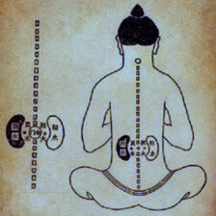
精
No looking! No listening! Hug your shén tightly, to thereby create stillness.
And your outer form will spontaneously square up.
You need stillness! You need purity and clarity!
Do not exhaust your outer form, and do not rattle your jīng!
Only thus can you lengthen your life.
Zhuāngzi, Outer Chapters
Wilms trans.
Jīng Essence

Slide 38
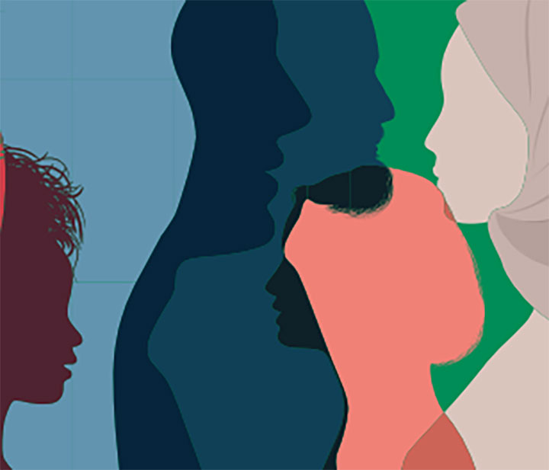
合陰陽
Preserving the Jing – Sexual Health
For Men:
-Sex is healthy! Ejaculation is depleting
-Limit ejaculation based on age and state of health.
-There are male sexual practices that are beyond the scope of this presentation
For Women:
Limit activity during Menstruation, including sexual activity
There are female sexual practices that are beyond the scope of this presentation
Arts of the Bedchamber

Slide 39
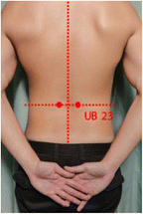
Point Press & Massage
腎俞 – Shènshù
Kidney Point
This point is located 1.5 cun (inch) lateral to the lower border of the spinous process of the second lumbar vertebra (L2), roughly equal with the top of the hips.
Method 1: Rub or press these points in whatever way you can. Laying down or having someone rub them for you may be easier.
Method 2: Make your hands into fists, with the tiger’s mouth (the area that connects the thumb and forefinger), massage these points in circles, first clockwise then counterclockwise 36 or more times. Skin on skin is best.
This point can help with:
-Low Back Pain
-Any Kidney or urinary issues
-Sexual issues
-Menstrual issues
-Fatigue
-Diarrhea
-Age related hearing and vision problems

Slide 40
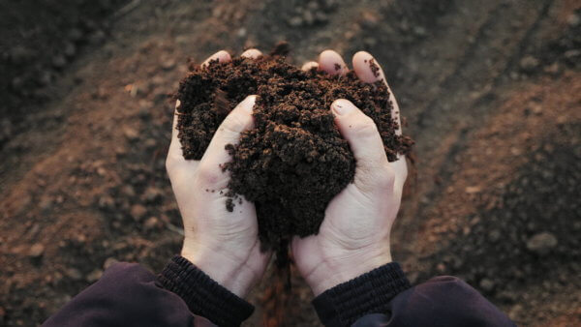
Earth / Soil
三十輻，共一轂，當其無，有車之用。
埏埴以為器，當其無，有器之用。
鑿戶牖以為室，當其無，有室之用。
故有之以為利，無之以為用。
Thirty spokes converge upon a single hub;
It is on the hole in the center that the use of the cart hinges.
We make a vessel from a lump of clay;
It is the empty space within the vessel that makes it useful.
We make doors and windows for a room;
But it is these empty spaces that make the room livable.
Thus, while the tangible has advantages,
It is the intangible that makes it useful.
Dao De Jing 11 – Wu trans.

Slide 41
Earth / Soil
Resonance
Season | Late Summer / Seasonal Change
Direction | Center
Yin Organ | Spleen/Pancreas
Yang Organ | Stomach
Action | Transformation
Flavor | Sweet
Tissue | Muscles/Flesh
Sense Organ | Tongue
Color | Yellow / Amber / Gold
Negative Emotion | Worry
Virtue | Sincerity, Faithfulness -信 Xìn
“Eat food. Not too much. Mostly plants.”
― Michael Pollan, In Defense of Food: An Eater's Manifesto

Slide 42
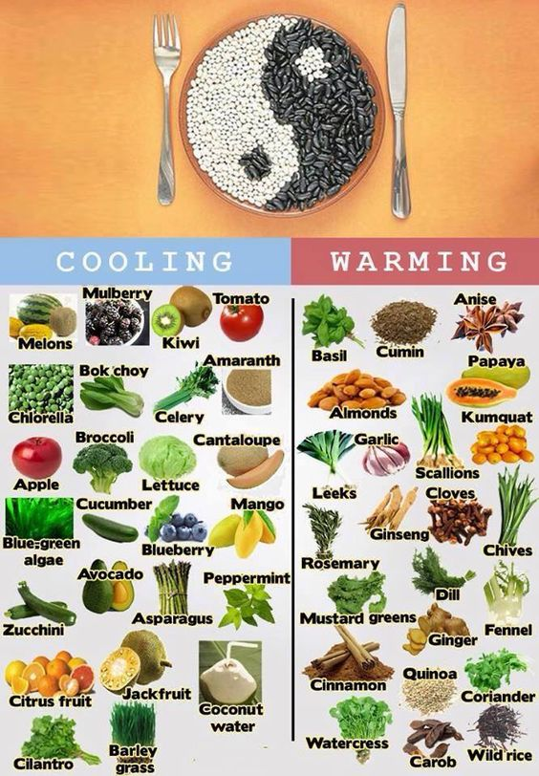
Dietetics
-Eat with regularity and according to the seasons and the clock
“Eat breakfast yourself, share lunch with a friend, give dinner to your enemy”
-Eat a wide variety of foods utilizing the 5 (6 actually) flavors and 5 colors
-Flavors are Sour, Bitter, Sweet, Acrid, Salty and Bland
-Colors are Green (or blue), Red, Yellow (or orange), White, Purple (or black)
-Unless you have a very hot constitution, avoid cold and raw foods, and ice drinks especially in the colder seasons
- The Spleen/Stomach likes sweet but not too sweet! Avoid processed and refined sugars and simple carbs

Slide 43
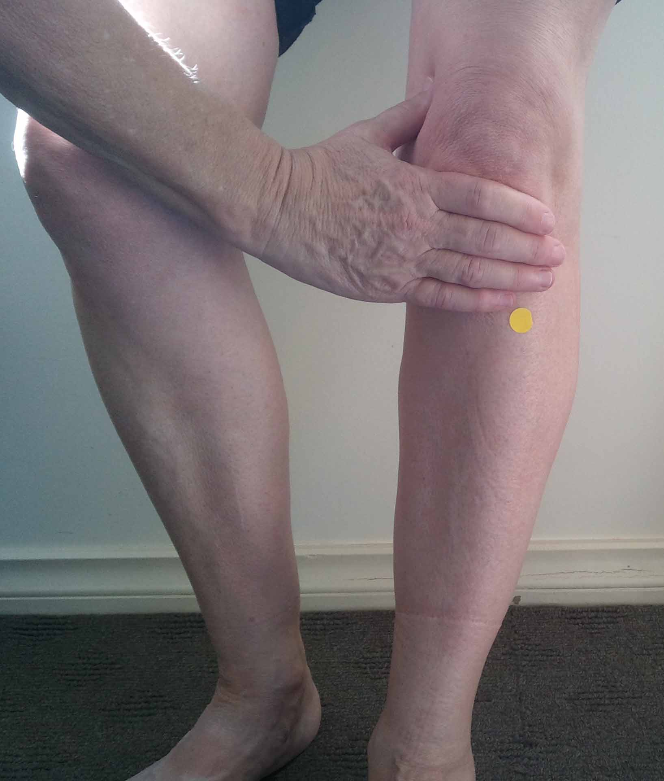
Stomach and Spleen Health
-Massage the abdomen in large slow circles 36x each direction
-Bring hands to the solar plexus and breathe golden light into the stomach
-Continue for as long as you like
-Point Press 足三里 Zú sān lǐ St-36
飯後百步走，活到九十九
Walk 100 steps after a meal and live to be 99
-Chinese Saying

Slide 44
  Conclusion
  Where to from here?
  -Start paying attention! Feel how the rhythms of your body and the rhythms of nature are in resonance
  -Get outside! Be sure to bundle up in cold, damp, or windy weather
  -Don’t isolate yourself! Join a Tai Chi or Qi Gong class. Meet with others who are interested in maximizing their health
  -See an Acupuncturist! A qualified acupuncturist can tailor these practices to your needs and constitution
  -By gradually incorporating these Yǎngshēng practices into daily life, you can establish a health routine that promotes balance, longevity, and a deeper connection to yourself and nature.
-44

Slide 45
Reading & Resources
Books & Articles:
Nourishing Life the Yang Sheng Way
-Courtney, Dierdre
Yang Sheng: the Art of Chinese Self-Healing: Ancient Solutions to Modern Problems
-Brindle, Kate
Live Well Live Long: Teachings from the Chinese Nourishment of Life Tradition
-Deadman, Peter
The Healing Promise of Qi: Creating Extraordinary Wellness Through Qigong and Tai Chi
-Jahnke, Roger
Nourishing Life 養生 Yang Sheng: An Ancient Love of Lists
Wilcox, Lorraine - can be found at:
https://www.academia.edu/34453044/Nourishing_Life_%E9%A4%8A%E7%94%9F_Yang_Sheng_An_Ancient_Love_of_Lists
Web Resources:
My Website: Mattvandykelac.com
Linda’s Website: Lindataichi.com
Washington Acupuncture & Eastern Medicine Association: Mywaema.org
Middle Way Acupuncture Institute, Mount Vernon WA: Mwai.edu

Slide 46
Thank You!
Matt Van Dyke aemp
360.466.1800
  matt@mattvandykelac.com
  www.mattvandykelac.com

